Slide 1





PRESENTATION 2026
Smart Edu: Optimizing Institutional Resource
Allocation for Maximum Academic ROI
Mentor Name
Student Name
Student Email
Uma Maheswari
Diya Maheshwari
Maheshwaridiya75@gmail.com

Slide 2

Outline
Abstract of the Project
Problem Statement
Proposed Solution
System Architecture
Live Demo of the Project
Embedded Video of Project
Conclusion
Future Scope

Slide 3
Abstract
Goal: Quantify the "Academic ROI" of institutional resources by linking spending to exam performance.
Tech Stack: Built using Excel, Power BI, and Microsoft Copilot Studio.
Core Deliverable: An interactive ROI Dashboard + "Edu-Advisor" AI Chatbot for natural language querying.
The "Smart" Edge: Converts 6,500+ static records into a real-time, AI-driven decision engine.

Slide 4
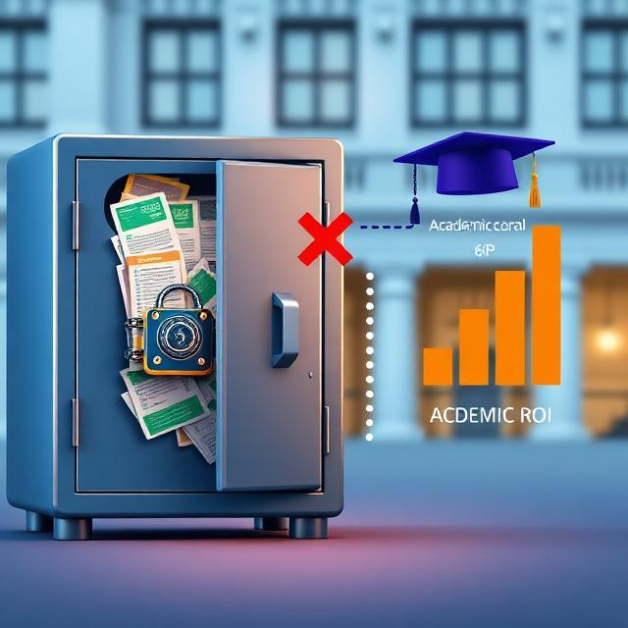
Problem Statement
Educational institutions lack a measurable framework to track the actual "Academic ROI" of their expenditures, leaving critical success drivers trapped in static spreadsheets and leading to misallocated funding.

Slide 5
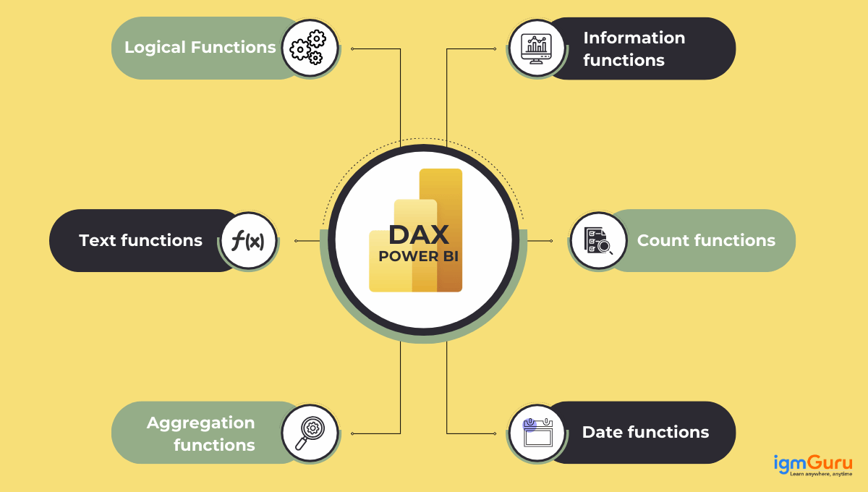

Proposed Solution
The Core Strategy: Transition the institution from "guesswork budgeting" to a measurable, data-driven funding model that tracks actual "Academic ROI".
How It Works: It audits historical student performance against institutional expenditures to isolate the true drivers of academic success. It also uses DAX measures for Analysis. DAX measures are identified with the help of AI.

Slide 6
The Business Impact:
Eliminates Wasted Capital: Replaces the inefficient "one-size-fits-all" spending approach with targeted, demographic-specific interventions.
Strategic Prioritization: Delivers an "Investment Prioritization Matrix" that guides school boards on exactly where to allocate funds first for the highest academic yield.
Executive Agility: Transforms static spreadsheets into an interactive executive dashboard for real-time tracking (with the option to layer on an AI-query assistant for non-technical staff).
Reconsider
Invest Strategically
Deprioritize
Quick Wins

Slide 7
System Architecture
Strategic Data Ingestion
Data Structuring & Standardization
Excel Power Query
Business Intelligence Modelling
Power BI Desktop
Actionable Executive Output
Interactive academic ROI Dashboard
Standalone AI Chatbot
Student Performance Records From Kaggle
EDU- ADVISOR

Slide 8
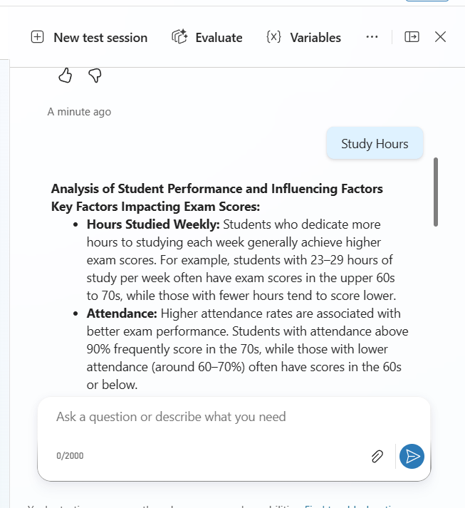
Live Demo of Project
Here's the list of some demo screenshots / features of the project:
Github Repo Link
Video Presentation
Screenshot of chatbot
https://github.com/maheshwaridiya/AICW-PROJECT
https://youtu.be/YoWYBQZYdwY

Slide 9

Conclusion
Accomplishment: Built a full Business Intelligence pipeline from raw data to advanced visualization.
Key Findings: Successfully isolated the statistical drivers of performance from low-impact variables.
Objective Met: Bridged complex analytics with intuitive Power BI dashboards and AI.
Final Impact: Delivered an actionable, enterprise-grade tool to maximize academic yield per Rupee spent.
CONCLUSION

Slide 10

Future Scope
Live Integration: Connect the Power BI model via API to live school management databases.
Predictive AI: Use Machine Learning to flag at-risk students before the semester starts.
Agent Integration: Upgrade licenses to directly embed the AI Chatbot inside the Power BI environment.
Scalability: Expand the model to handle district-wide or state-wide academic data.

Slide 11
Thank You
AICW Fellowship | Student Project Presentation 2026
LinkedIn | Edunet Foundation

